Slide 1
GDP 1 Project Manager Briefing - Group C

Slide 2
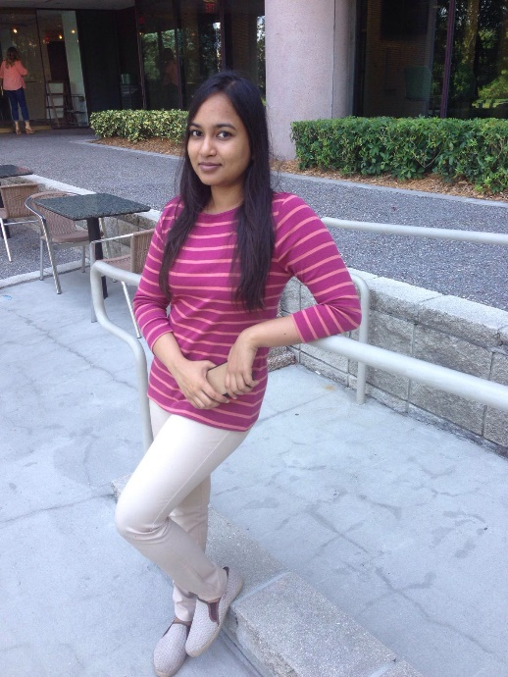
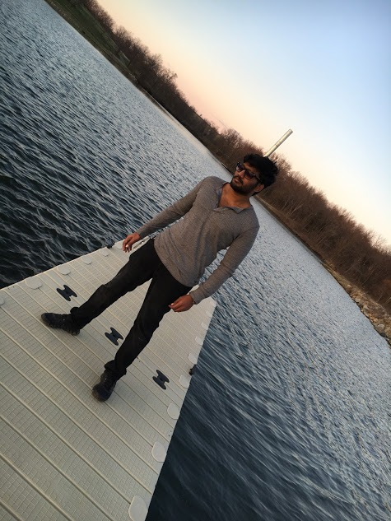
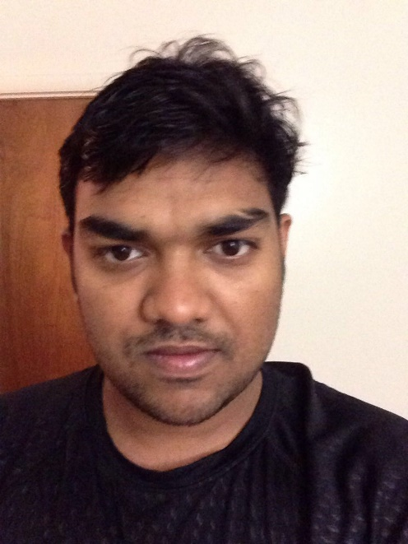
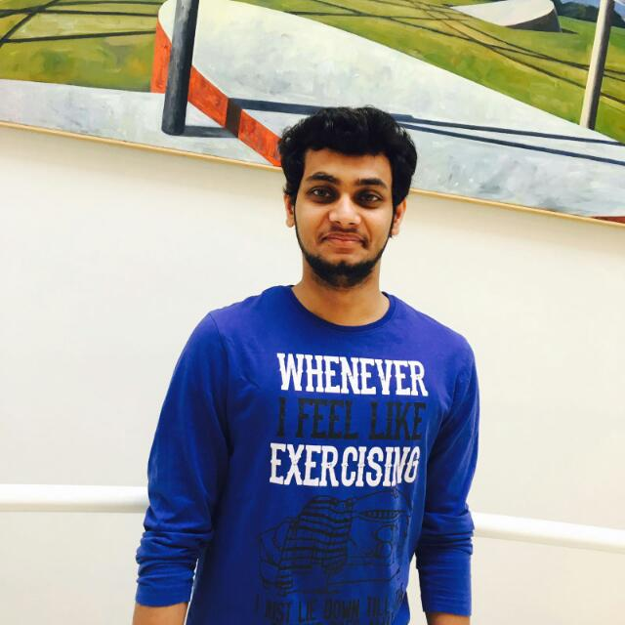
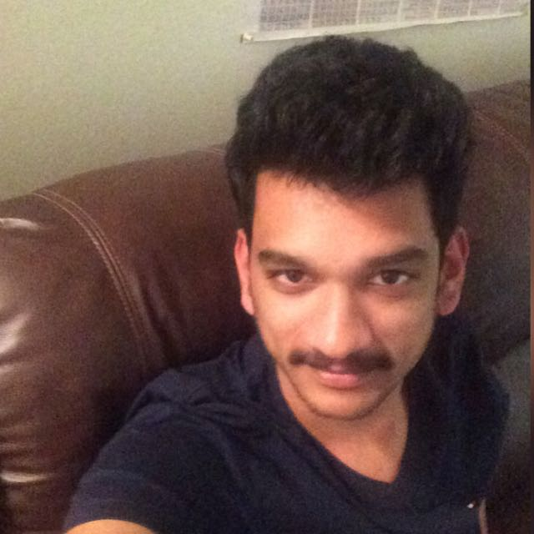
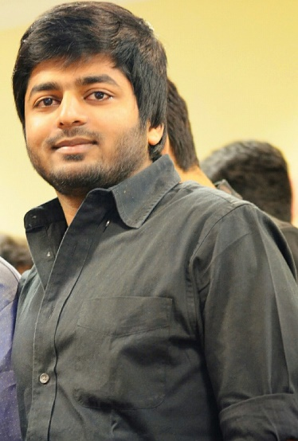
Crazy Coders
Sneha
Teja
Mallikharjuna
Nayan
Rakesh
Vamsee

Slide 3
Client Information
Dr. Michael Oudshoorn
Office: Colden Hall 2147
Phone: 660-562-1764
Email: oudshoorn@nwmissouri.edu

Slide 4
Campus Cruise Android
A Campus tour app which is interactive and dynamic
Gives Audio heads up
Scans QR codes on building and retrieve details
Tracks the user’s path on a map
Shows the un-visited places in Campus
Shows the updated list of ongoing events on campus

Slide 5


Project Stack
Android
Google Maps API

Slide 6
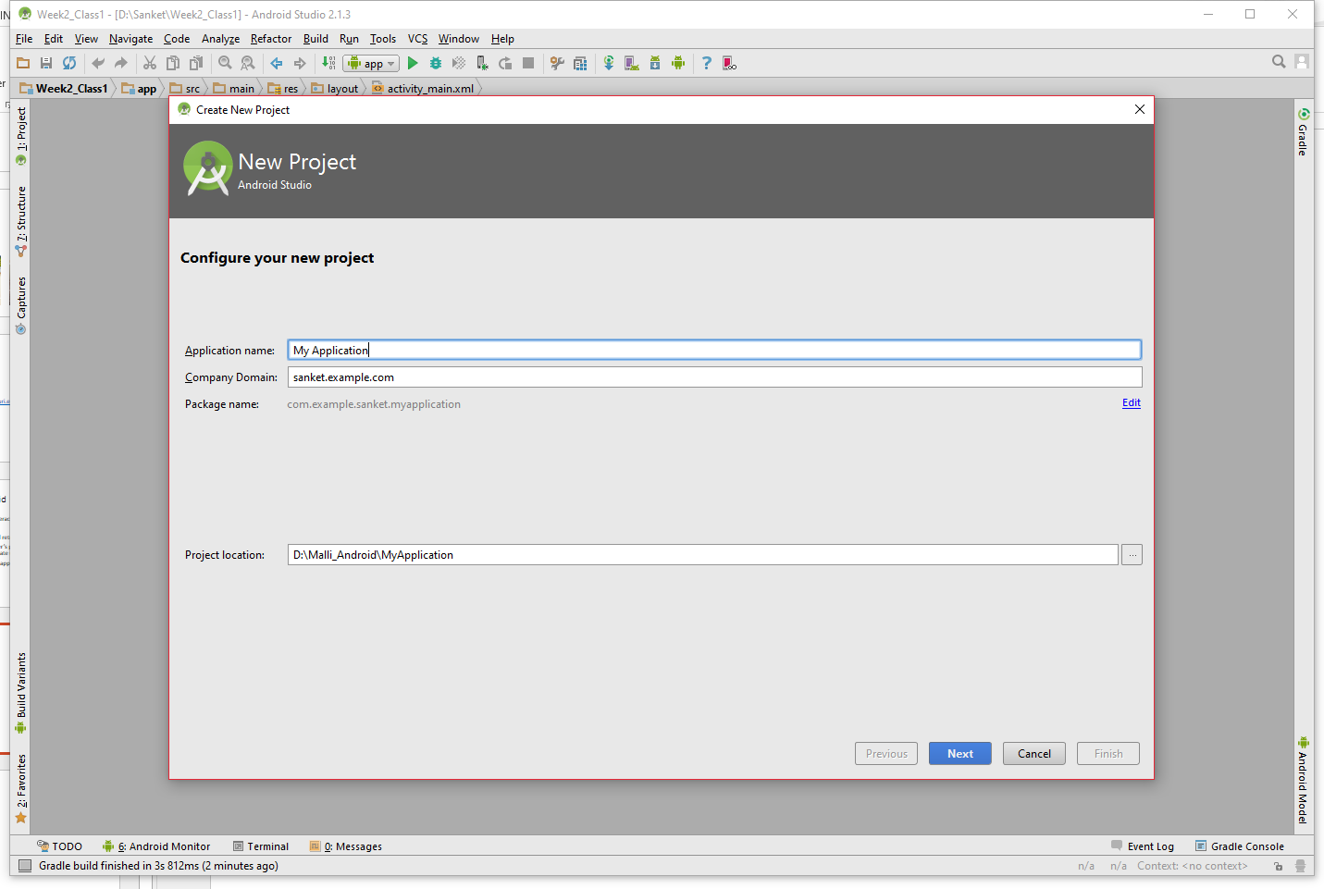
Planned IDE
Android Studio

Slide 7

Build Tool
Gradle

Slide 8

Source Code Host
GitHub

Slide 9


Hosting of the App
In development phase the app will be locally hosted
We plan to host it in Google Play Store and Amazon App Store post development

Slide 10
Collaboration
Team Sigma will be helping us in the testing phase

Slide 11
Artifacts
User stories / use cases –To be discussed
Requirements document – Completed
User interface storyboards / sketches – To be discussed
Test plan - To be discussed
Architectural prototype - To be discussed

Slide 12
Thank you!

Slide 13
Questions?

